Slide 1

RSA
Presenters:
Peter Chung
Aaron Ko
Xinying Wang
Wenbin Wu

Slide 2
Our Problem
Bob sent Alice an encrypted message using the RSA cryptosystem, and the English plaintext was first converted to a numerical value by taking the place of each letter in the alphabet (1-26).
Alice's Public information:
e = 17
n = 8914790480356739698870346064785063349538970900960080554109204000262737
Bob's encrypted message is 140180363337540631324869726839735108443782598997060166135172957494938

Slide 3

Question: What’s Bob’s message?
Decryption of RSA Cryptosystem:
Bob’s message $m$ is encrypted $m^{e}(mod n)$
To decrypt the message we need to calculate $d≡e^{−1}\left(mod φ\left(n\right)\right)$.
Then the message $m$ can be simply recover by
$${m≡\left(\left(m^{e}(mod n\right)\right)}^{d}(mod n)$$

Slide 4

How do we factor $n$?
A Naive Attempt: Brute Force
Result: WE GOT A FACTOR: 2707
We got this factor in less than a second.
But it did not give us a second after weeks……

Slide 5


Factor $\frac{n}{2707}$
Check if it is a product of two consecutive primes.
If yes, we know the average gap between the two consecutive primes is $\ln\left(\frac{n}{2707}\right).$
Then we can find it using brute force to check whether $\frac{n}{2707}$ has a factor in the interval $\frac{n}{2707}±$ $\ln\left(\frac{n}{2707}\right)$.
Result: We didn’t find any. Thus $\frac{n}{2707}$ is not a product of two consecutive primes.

Slide 6


Factor $\frac{n}{2707}$ using Fermat’s method
Let $k=\frac{n}{2707}$.
We want to find $u, v$ such that $u^{2}≡v^{2}(mod k)$, where $u≢v(mod k)$.
If we are able to find such $u, v$ then $GCD(u^{2}−v^{2},k)$ is a factor of $k$.
We run this algorithm for a long time, it doesn’t give us a result.
Problem for this method:
This algorithm is good for there exits a factor that’s close to $\sqrt{k}$.
Our $k$ is 67 digit integer, even if we assume the pair of factors are both 34 digits, the difference of factor and $\sqrt{k}$ can get as large as a 33 or 34 digits number, which is too large to compute.

Slide 7

Fermat’s Method
Example: To factor 119.
We will start from $u=\left\lceil 119\right\rceil =11$, keep increment it by 1, check when does $u^{2}−119$ is a perfect square.
$${11}^{2}−119=121−119=2$$
$${12}^{2}−119=144−119=25=5^{2}$$
Then we found ${12}^{2}≡5^{2}\left(mod 119\right).$
$$GCD\left(12−5,119\right)=GCD\left(7,119\right)=7$$
7 is a factor of $119=7∙17$

Slide 8

Quadratic Sieve
Quadratic Sieve used the similar idea of Fermat’s method, where eventually we want to find $u, v$ such that $u^{2}≡v^{2}(mod k)$, where $u≢v(mod k)$.
But find such $u, v$ is hard. So we start with some $x$, computing prime factorization of $x^{2}(mod n)$ . And try to select some of the $x^{2}(mod n)$ such that the product of them modulo $n$ is a perfect square.
Let’s look at an example.

Slide 9

Example: Factor 2041, where $x$ starts from $\left\lceil \sqrt{2041} \right\rceil =46$
${ 46}^{2}\left(mod 2041\right)≡ 75≡3×5^{2}$
$${ 47}^{2}\left(mod 2041\right)≡168≡2^{3}× 3 ×7$$
$${ 48}^{2}\left(mod 2041\right)≡263$$
$${49}^{2}\left(mod 2041\right)≡360≡2^{3}× 3^{2} ×5$$
$${ 50}^{2}\left(mod 2041\right)≡459≡{ 3}^{3} ×17$$
$${ 51}^{2}\left(mod 2041\right)≡560≡2^{4}×5 ×7$$

Slide 10
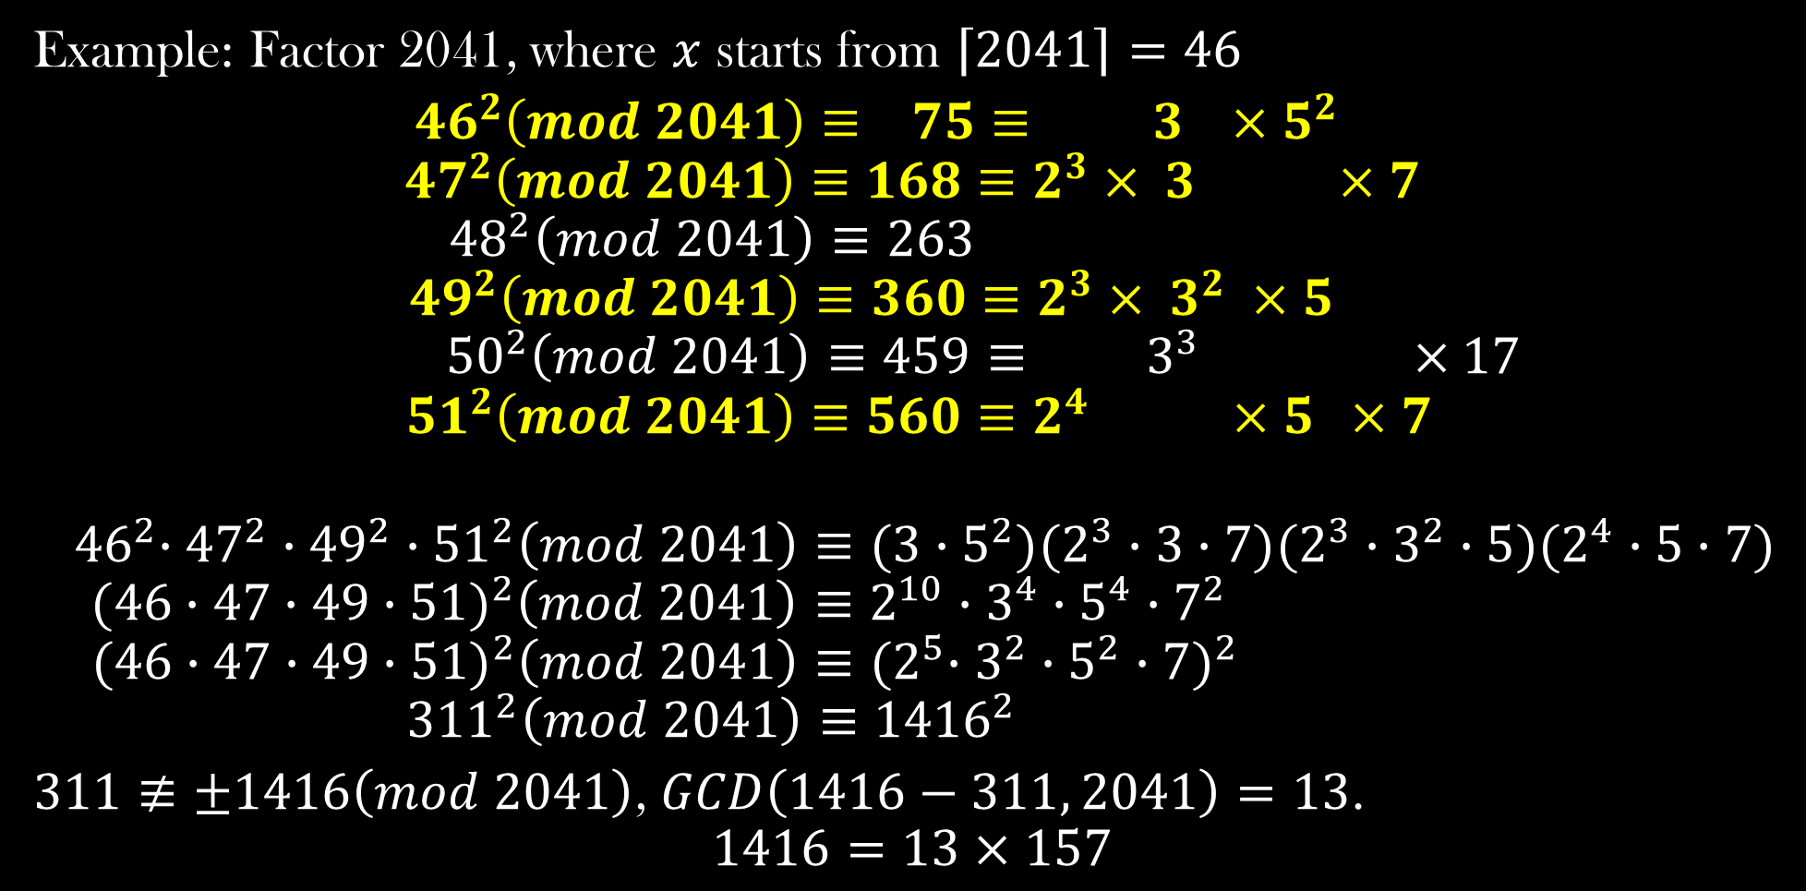
Example: Factor 2041, where $x$ starts from $\left\lceil 2041\right\rceil =46$
${ 46}^{2}\left(mod 2041\right)≡ 75≡ 3 ×5^{2}$
$${ 47}^{2}\left(mod 2041\right)≡168≡2^{3}× 3 ×7$$
$${48}^{2}\left(mod 2041\right)≡263$$
$${49}^{2}\left(mod 2041\right)≡360≡2^{3}× 3^{2} ×5$$
$${ 50}^{2}\left(mod 2041\right)≡459≡{ 3}^{3} ×17$$
$${ 51}^{2}\left(mod 2041\right)≡560≡2^{4} ×5 ×7$$
$${ 46}^{2}∙{47}^{2}∙{49}^{2}∙{51}^{2}\left(mod 2041\right)≡(3∙5^{2})(2^{3}∙3∙7)(2^{3}∙3^{2}∙5)(2^{4}∙5∙7)$$
$${(46∙47∙49∙51)}^{2}\left(mod 2041\right)≡2^{10}∙3^{4}∙5^{4}∙7^{2}$$
$${(46∙47∙49∙51)}^{2}\left(mod 2041\right)≡{{(2}^{5}∙3^{2}∙5^{2}∙7)}^{2}$$
$${311}^{2}\left(mod 2041\right)≡{1416}^{2}$$
$311≢±1416\left(mod 2041\right)$, $GCD\left(1416−311, 2041\right)=13$.
$$1416=13×157$$

Slide 11

B-smooth Number
We need to find a bound on the largest prime factors of $x_{i}^{2}(mod n)$.
Let $Q\left(x_{i}\right)=x_{i}^{2}−n.$
Instead of having all $Q\left(x_{i}\right)$, we now only want the $Q\left(x_{i}\right)$ where all its prime factors are at most B. We call this kind of number B-smooth number.

Slide 12


If we have enough $Q\left(x_{i}\right)$ that are B-smooth number…
Then we will have
$$Q\left(x_{0}\right)≡p_{0}^{a_{00}}p_{1}^{a_{01}}p_{2}^{a_{03}}…p_{k}^{a_{0k}}$$
$$Q\left(x_{1}\right)≡p_{0}^{a_{10}}p_{1}^{a_{11}}p_{2}^{a_{12}}…p_{k}^{a_{1k}}$$
$$…$$
$$Q\left(x_{n}\right)≡p_{0}^{a_{n0}}p_{1}^{a_{n1}}p_{2}^{a_{n2}}…p_{k}^{a_{nk}}$$
Where all $Q\left(x_{i}\right)$ is a $p_{k}$-smooth number, and $p_{0},…,p_{k}$ are all the possible prime factors for any $Q\left(x_{i}\right)$ .

Slide 13

Factor Base
We call all the possible prime factors for any $Q\left(x_{i}\right)$ factor bases.
Notice not all the primes are factor bases. Observe the following:
$$x^{2}≡Q\left(x\right)={p_{0}p}_{1}p_{2}…p_{k} (mod n)$$
$Q\left(x\right)=x^{2}−n={p_{0}p}_{1}p_{2}…p_{k}$
$$x^{2}={p_{0}p}_{1}p_{2}…p_{k}+n \left(mod p_{i}\right)$$
$$x^{2}≡0+n \left(mod p_{i}\right)$$
$$x^{2}≡n \left(mod p_{i}\right)$$
Therefore, $p_{i}$ is a possible factor of $Q\left(x_{i}\right)$ only if $n$ is a quadric residue of $p_{i}$. Where we can use Legendre Symbol to check whether a prime is a factor base, i.e., check $\left(\frac{n}{p_{i}}\right)==1.$

Slide 14


Convert the $Q\left(x_{i}\right)$ list to matrix representation
$$Q\left(x_{0}\right)≡p_{0}^{a_{00}}p_{1}^{a_{01}}p_{2}^{a_{03}}…p_{k}^{a_{0k}}$$
$$Q\left(x_{1}\right)≡p_{0}^{a_{10}}p_{1}^{a_{11}}p_{2}^{a_{12}}…p_{k}^{a_{1k}}$$
$$…$$
$$Q\left(x_{n}\right)≡p_{0}^{a_{n0}}p_{1}^{a_{n1}}p_{2}^{a_{n2}}…p_{k}^{a_{nk}}$$
$$A=\left[\begin{aligned}\begin{aligned}a_{00} a_{01} a_{02} … a_{0k} \\ a_{10} a_{11} a_{12} … a_{1k}\end{aligned} \\ … \\ a_{n0} a_{n1} a_{n2} … a_{nk}\end{aligned}\right]$$
We want to select some of $Q\left(x_{i}\right)$ such that the product of them is a perfect square, i.e., the prime factorization of the product will have even powers on all the prime factors.

Slide 15

How do we use matrix?
$${\left[\begin{aligned}s_{0} \\ s_{1} \\ … \\ s_{n}\end{aligned}\right]}^{T} \left[\begin{aligned}\begin{aligned}a_{00} a_{01} a_{02} … a_{0k} \\ a_{10} a_{11} a_{12} … a_{1k}\end{aligned} \\ … \\ a_{n0} a_{n1} a_{n2} … a_{nk}\end{aligned}\right]=\left[r_{0} r_{1} … r_{n}\right]$$
We want to find the solution column $s$ such that $s^{T}A=$ R, where the entries of the $s$ is either 0 or 1, and the result matrix will have all even entries. If the entry $s_{i}$of the solution column $s$ is 1, then we select the corresponds $x_{i}$.
Since we only care about the parities of the entries, we can modify our matrix such that it’s under GF[2].

Slide 16

Matrix under GF[2]
$${\left[\begin{aligned}s_{0} \\ s_{1} \\ … \\ s_{n}\end{aligned}\right]}^{T} \left[\begin{aligned}\begin{aligned}a_{00} a_{01} a_{02} … a_{0k} \\ a_{10} a_{11} a_{12} … a_{1k}\end{aligned} \\ … \\ a_{n0} a_{n1} a_{n2} … a_{nk}\end{aligned}\right]=\left[0 0 … 0\right]$$
Now we want to find the solution column $s$ such that${ s}^{T}A=$ 0, where the all the entries are either 0 or 1. The solution column $s$ is also call the zero vector of our matrix $A$.

Slide 17


Challenge we face to factor $k$, a 67-digit integer
To find the value of $B$, for our B-smooth number.
To find enough B-smooth numbers.
Start from a interval:
$$\left[Q\left(x_{0}\right),Q\left(x_{1}\right),Q\left(x_{2}\right),Q\left(x_{3}\right),Q\left(x_{4}\right)…\right]$$
Check which $Q\left(x_{i}\right)$ in the interval is B-smooth number.

Slide 18

Attempt 1 – Sieving by go through each element in the interval
We tried to sieve number by simply divide $Q\left(x_{i}\right)$ by every prime number, but it is very inefficient, for a obvious reason, not every prime can be possible prime factor of $Q\left(x_{i}\right)$.

Slide 19

Attempt 1 – Sieving by go through each element in the interval
We tried to sieve number by simply divide $Q\left(x_{i}\right)$ by every prime number, but it is very inefficient, for a obvious reason, not every prime can be possible prime factor of $Q\left(x_{i}\right)$.
So we modify out algorithm:
To sieve number by divide $Q\left(x_{i}\right)$ by every prime in the factor base list.

Slide 20

Attempt 2 – Sieving by “jumping”
Observe the following relation:
$$Q\left(x\right)=x^{2}−n$$
$$Q\left(x+kp_{i}\right)={(x+kp_{i})}^{2}−n$$
$$=x^{2}+2xkp_{i}+k^{2}p_{i}^{2}−n (mod p_{i})$$
$$=x^{2}−n(mod p_{i})$$
Thus, if $p_{i}$ divides $Q\left(x\right)$, then $Q\left(x+kp_{i}\right)$ is divisible by $p_{i}$ for all integer $k$, while $Q\left(x+kp_{i}\right)$ is in the interval. Which allow us to do the sieving by “jumping”.

Slide 21

Attempt 2 – Sieving by “jumping”
To sieve each $p_{i}$in the factor base list, instead of go through the whole interval, we go through the first $p_{i}$ element in the interval, if $Q\left(x_{j}\right)$ is divisible by $p_{i}$, then for all $Q\left(x_{j}+kp_{i}\right)$in the interval, sieve $p_{i}.$
This algorithm is not optimal, since when out $p_{i}$ get large, i.e., 5 digits primes, to check whether p divides $Q(x_{i})$for each $0≤i<p$, is a lot of work.

Slide 22

Attempt 2 – Sieving by “jumping”
To sieve each $p_{i}$in the factor base list, instead of go through the whole interval, we go through the first $p_{i}$ element in the interval, if $Q\left(x_{j}\right)$ is divisible by $p_{i}$, then for all $Q\left(x_{j}+kp_{i}\right)$in the interval, sieve $p_{i}.$
This algorithm is not optimal, since when out $p_{i}$ get large, i.e., 5 digits primes, to check whether p divides $Q(x_{i})$for each $0≤i<p$, is a lot of work.
To modify this algorithm, we will implement the Tonelli-Shanks algorithm to solve where exactly is $Q\left(x_{j}\right)$, where $p_{i}|Q\left(x_{j}\right).$ Since if $p_{i}|Q(x_{j})$, $\left(\frac{n}{p_{i}}\right)=1$, i.e., $x_{j}^{2}≡n(mod p_{i})$, $Q\left(x_{j}\right)≡x_{j}^{2}−n≡0(mod p_{i})$, then $p_{i}|Q\left(x_{j}\right).$

Slide 23
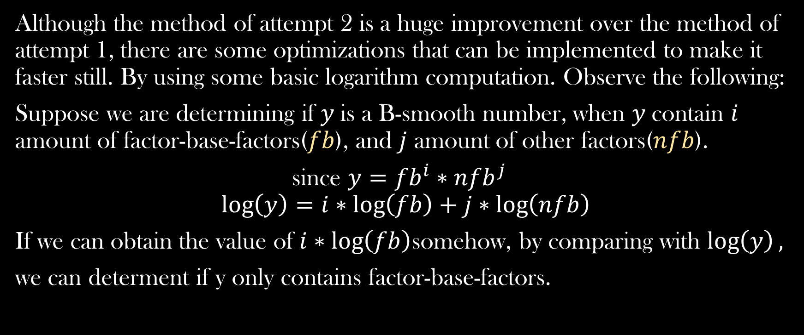
Attempt 3 – Our Optimal attempt
Although the method of attempt 2 is a huge improvement over the method of attempt 1, there are some optimizations that can be implemented to make it faster still. By using some basic logarithm computation. Observe the following:
Suppose we are determining if $y$is a B-smooth number, when $y$contain $i$ amount of factor-base-factors($fb$), and $j$ amount of other factors($nfb$).
since $y={fb}^{i}∗{nfb}^{j}$
$$\log\left(y\right)=i∗\log\left(fb\right)+j∗\log\left(nfb\right)$$
If we can obtain the value of $i∗\log\left(fb\right)$somehow, by comparing with $\log\left(y\right),$
we can determent if y only contains factor-base-factors.

Slide 24

Attempt 3 – Our Optimal attempt
Algorithm:
Interval: $\left[Q\left(x_{0}\right),Q\left(x_{1}\right),Q\left(x_{2}\right),Q\left(x_{3}\right),Q\left(x_{4}\right),…\right]$
logTrack: $\left[0, 0, 0, 0, 0,…\right]$
For each $p_{i}$ in the factor base list:
Use the Tonelli-Shanks algorithm to solve where exactly is
$Q\left(x_{j}\right)$, where $p_{i}|Q\left(x_{j}\right).$
logTrack$[j]$ = logTrack$\left[j\right]+log(p_{i})$
For $Q\left(x_{i}\right)$ in the interval:
if (logTrack$\left[i\right]≥log\left(Q\left(x_{i}\right)\right)$) return $x_{i}$

Slide 25

Attempt 3 – Our Optimal attempt
Although the algorithm is very efficient, when $y$ has $k$ power of a factor-base-factor, $a$ , it could only obtain the value of $\log\left(fb_{a}\right)$ instead of $k∗\log\left(fb_{a}\right).$
Suppose $y$ is a possible-B-smooth number, where $y=a^{2}∙b∙c^{3}∙d$ and $a, b, c$are primes at most B, d is unknown factor.
$$log⁡(y)={log⁡(a}^{2})+log⁡(b)+log⁡(c^{3})+log⁡(d)$$
$$=2\log\left(a\right)+\log\left(b\right)+3\log\left(c\right)+log⁡(d)$$
What we could obtain from the algorithm:
$$V=log\left(a\right)+\log\left(b\right)+\log\left(c\right)$$
If $\log\left(y\right)≤V+\log{⁡(B)}$, we could already tell the unknown $d$must be less than B thus $y$ is a $B$-smooth number

Slide 26

Attempt 3 – Our Optimal attempt
So we consider $\log{⁡(B)}$ as an error bound candidate.
However, if the $\log\left(y\right)≥V+\log{⁡(B)}$, then the program will return false while $\log\left(y\right)−V$can be log of a product of a bunch primes less than B, then we will miss a good smooth number. So adding error bound to the algorithm is still not deterministic even though it could helps catching more smooth numbers .
In practice, we tried testing natural numbers between $log⁡(B)−5$to $log⁡(B)+5$as our error bound, turned out $log⁡(B)−2$give us the best result.

Slide 27
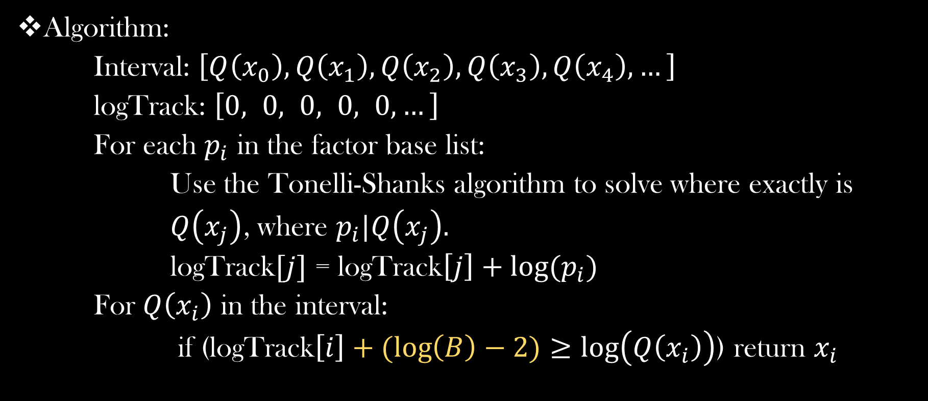
Attempt 3 – Our Optimal attempt
Algorithm:
Interval: $\left[Q\left(x_{0}\right),Q\left(x_{1}\right),Q\left(x_{2}\right),Q\left(x_{3}\right),Q\left(x_{4}\right),…\right]$
logTrack: $\left[0, 0, 0, 0, 0,…\right]$
For each $p_{i}$ in the factor base list:
Use the Tonelli-Shanks algorithm to solve where exactly is
$Q\left(x_{j}\right)$, where $p_{i}|Q\left(x_{j}\right).$
logTrack$[j]$ = logTrack$\left[j\right]+log(p_{i})$
For $Q\left(x_{i}\right)$ in the interval:
if (logTrack$\left[i\right]+(\log\left(B\right)−2)≥log\left(Q\left(x_{i}\right)\right)$) return $x_{i}$

Slide 28
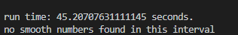
Scale the size of our factor base
We used different factor base sizes to run for a sieving interval size of 20,000,000, half positive and half negative. We used the time and the number of smooth numbers found in this time period, to calculate estimating time it needs to get a good amount of smooth numbers for matrix calculations. (for factor base size = 10000)

Slide 29

Scale the size of our factor base
We end up decided using a factor base size of 40000 (not included $−1$).
Our B is 1,013,741.

Slide 30
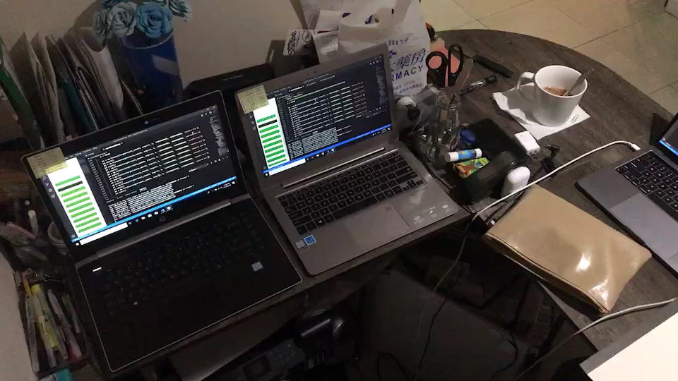

Searching for smooth numbers of factor base size of 40001, including $−1$as a factor base.
We run the optimal algorithm parallelizable on all the CPUs on about 10 laptops overnight from range -400,000,000,000 to 400,000,000,000. On average, we got about 3-5 smooth numbers in every ten million interval, one blocks. And we got about eighty thousand smooth numbers in this range. We randomly combines about sixty-five thousand smooth numbers from all the smooth numbers files we got from all the computers, 25,578 smooth numbers to be exact.

Slide 31
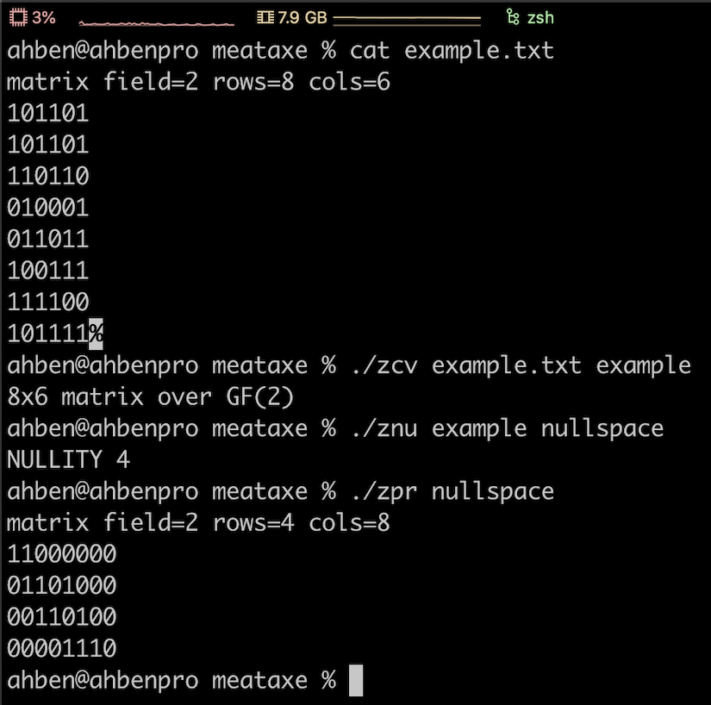
Using Meataxe to solve for our relations

Slide 32


Using Meataxe to solve for our relations
We converts our smooth numbers file to bit-string representing the parity of the exponents of the prime factorization of each of our smooth number. When we store the bit-string input file of the matrix, we also have a reference file that store the x value of bit-string of $Q(x)$in the same order of the bit-string value. So that later, we can easily track back which $x$ to select.
$$Q\left(x_{0}\right)≡p_{0}^{a_{00}}p_{1}^{a_{01}}p_{2}^{a_{03}}…p_{k}^{a_{0k}}$$
$$Q\left(x_{1}\right)≡p_{0}^{a_{10}}p_{1}^{a_{11}}p_{2}^{a_{12}}…p_{k}^{a_{1k}}$$
$$…$$
$$Q\left(x_{n}\right)≡p_{0}^{a_{n0}}p_{1}^{a_{n1}}p_{2}^{a_{n2}}…p_{k}^{a_{nk}}$$
$$A=\left[\begin{aligned}\begin{aligned}a_{00} a_{01} a_{02} … a_{0k} \\ a_{10} a_{11} a_{12} … a_{1k}\end{aligned} \\ … \\ a_{n0} a_{n1} a_{n2} … a_{nk}\end{aligned}\right]$$

Slide 33

Using Meataxe to solve for our relations
Meataxe return us the null space of our matrix. The null space of the matrix $A$ is a set $Z$ of zero-vectors $z$ where $zA= 0$for all $z∈Z$. The zero-vectors in the null space are linearly independent. If our matrix A has dimension $m×n$, where $m$ represents the number of smooth numbers we are selected from and $n$ represents the size of out factor bases, the result of the null space will be $s×m$, where $s$ represents the number of zero vector in our null space.
Notice that each zero vector, a row in null space, has $m$ entries. A 1 in entry $i$of the zero vector represents select the smooth number that represented on the $i$th row of the input matrix.
Thus, the zero vector will tell us exactly which smooth numbers to select such that the product of those select one are a perfect square.

Slide 34

Result from Meataxe to solve our relations
We run the Meataxe on our 65,578$×$40,001 matrix, it only took about 20 minutes to return us the null space, which a lot quicker than what we expect, we were expecting it to run for a day.
The dimension of result null space of our matrix is 25,956$×$65,578, which we got 25,956 zero vectors. And from those zero vector we need to find non trivial factor of our k.
The output file consists all the entries of the result matrix, but 80 characters per line. So we convert the output file to an array $s[]$, where each element in $s[i]$is a bit string of length 65,578 representing the $i$th zero vector of the result null space.

Slide 35

Result from Meataxe to solve our relations
From the result we got, we figure out there is duplicate smooth numbers in our input file, since we got many zero vectors have only two 1s on the entries, and when we looked up the reference $x$ value, they are the same.
This happens to the first 500 zero vectors on our result null space, which means we might accidentally copied 500 smooth numbers twice into our input file when we’re trying to combine all the smooth number files from run the search smooth number algorithm parallelized.
However, it does not affect how we get the result, since the zero vectors on the null space are linearly independent.
The 501th and 502th zero vectors gave us a trivial factor. The 503th zero factors gives us the non trivial factor.

Slide 36
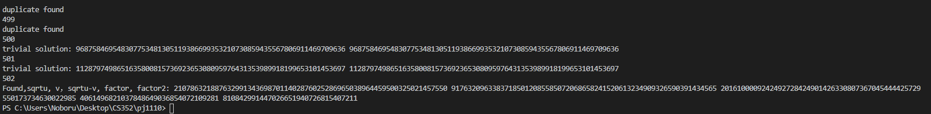

Result from Meataxe to solve our relations
We got the factors of $k$, which are 4061496821037848649036854072109281 and 810842991447026651940726815407211.
We use Miller Rabin to check whether the two factors are prime. Miller Rabin return true for both factors. Even though Miller Rabin is not deterministic when it returns true, since we set the round to 100, the probability of the value of Miller Rabin returned true is prime is very high. So we assume that Miller Rabin did a good job on checking the primality.

Slide 37

Decrypt the message
Now we know the factor of n, we can decrypt the message,
$$n=27074061496821037848649036854072109281 810842991447026651940726815407211$$
$$φ\left(n\right)=\left(2707−1\right)\left(4061496821037848649036854072109281−1\right)$$
$(810842991447026651940726815407211−1)$
$=3293236232122918248566806821124880000042518841670720653046819908800$
$$d≡{17}^{−1}\left(mod n\right)$$
$≡1743478005241544955123603611183760000022509975002146228083610539953$
$$m{≡\left(m^{e}\right)}^{d}(mod n)≡6211212156191521144114462118251997149625914714152089147$$

Slide 38
Convert the message to English plaintext
Since converting the numerical string to English plaintext is pretty trivial. We will manually converted by sight.
6 2 1 1 2 1 2 1 5 6 1 9 1 5 2 1 1 4 4 1 1 4 4 6 2 1 1 8 2 5 1 9 9 7 1 4 9 6 2 5 9 1 4 7 1 4 1 5 2 0 8 9 1 4 7
f 2 1 1 2 1 2 1 5 f 1 9 1 5 2 1 1 4 d a 1 4 d f 2 1 1 8 2 5 1 9 i g 1 4 i f 2 5 i 1 4 g 1 4 1 5 2 0 h i 1 4 g
f 21 12 12 15 f 19 15 21 14 d a 14 d f 21 18 25 19 i g 14 i f 2 5 i 14 g 14 15 20 h i 14 g
f u l l o f s o u n d a n d f u r y s i g n i f b e i n g n o t h i n g
Which give us the message “full of sound and fury sign if being nothing”. There is a little error when we conversion, “sign if being” supposed to be “signifying”, we made this mistake since “be” and “y” both have a numerical string of “25”. So the actual English plaintext is “full of sound and fury signifying nothing”, which is a quote from the speech Macbeth by Shakespeare.

Slide 39
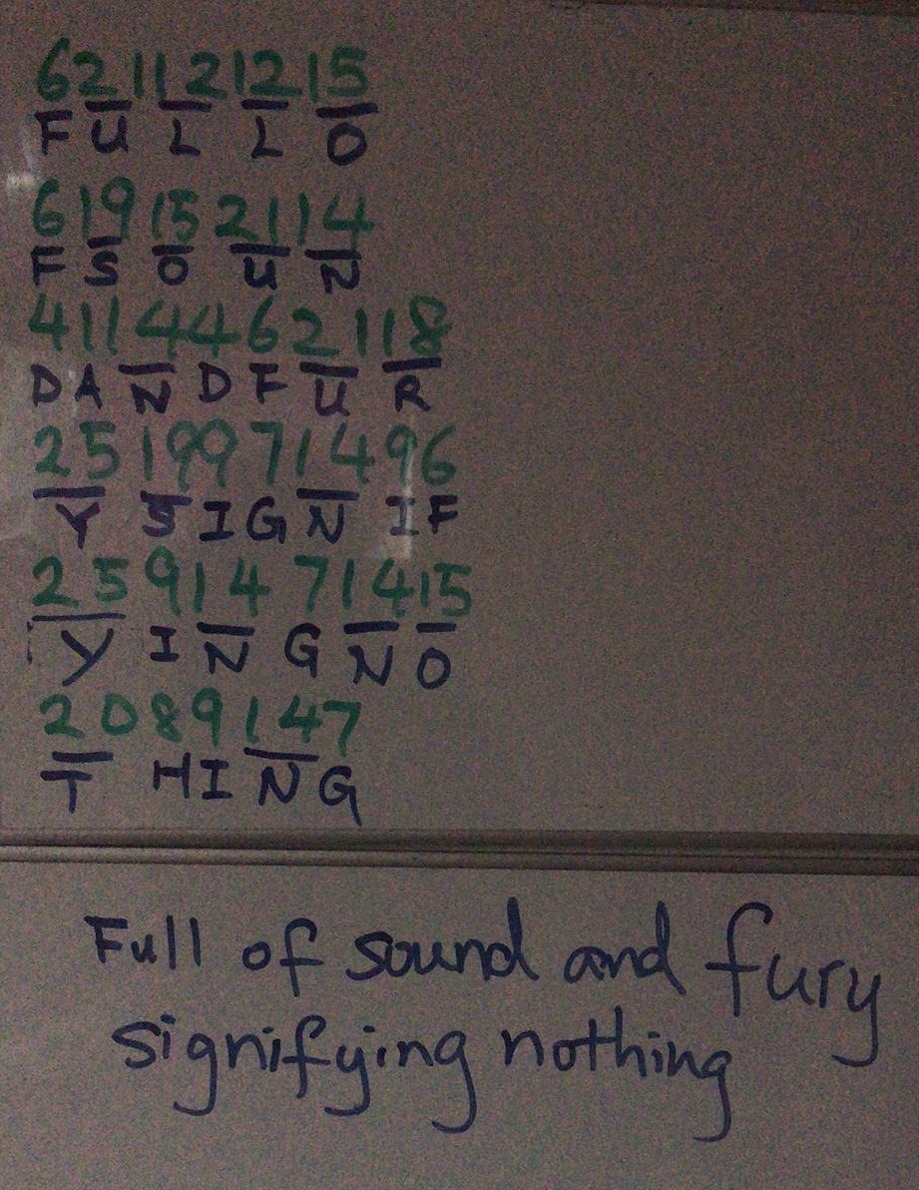
HURRAY!!!!!!!!!!! We break the cipher

